Slide 1
Java 8 Stream API

Slide 2
Outline
Java 8
Default Methods
Functional Interfaces
Lambda Expressions
Method References

Slide 3
Default Methods
In Context of Support For Streams
Java 8 needed to add functionality to existing Collection interfaces to support Streams (stream(), forEach())

Slide 4
Default Methods
Problem
Pre-Java 8 interfaces couldn’t have method bodies.
The only way to add functionality to Interfaces was to declare additional methods which would be implemented in classes that implement the interface
It is impossible to add methods to an interface without breaking the existing implementation

Slide 5
Default Methods
Solution
Default Methods!
Java 8 allows default methods to be added to interfaces with their full implementation
Classes which implement the interface don’t have to have implementations of the default method
Allows the addition of functionality to interfaces while preserving backward compatibility

Slide 6
Default Methods
Example
public interface A {
default void foo(){
System.out.println("Calling A.foo()");
}
public class Clazz implements A {}
Clazz clazz = new Clazz();
clazz.foo(); // Calling A.foo()

Slide 7
Functional Interfaces
Interfaces with only one abstract method.
With only one abstract method, these interfaces can be easily represented with lambda expressions
Example
@FunctionalInterface
public interface SimpleFuncInterface {
public void doWork();
Default test() {sout(“hello");};
static test1() {sout}
}
SimpleFuncInterface.test1();

Slide 8
Lambda expressions
A more brief and clearly expressive way to implement functional interfaces
Format: <Argument List> -> <Body>

Slide 9
Method References
Event more brief and clearly expressive way to implement functional interfaces
Format: <Class or Instance>::<Method>

Slide 10
Characteristics of Streams
Streams are not related to InputStreams, OutputStreams, etc.
Streams are NOT data structures but are wrappers around Collection that carry values from a source through a pipeline of operations.
Streams are designed for lambdas
Streams can easily be output as arrays or lists
Streams employ lazy evaluation
Streams are parallelizable

Slide 11
Creating Streams
From individual values
Stream.of(val1, val2, …)
From array
Stream.of(someArray)
Arrays.stream(someArray)
From List (and other Collections)
someList.stream()
someOtherCollection.stream()

Slide 12
Common Functional Interfaces Used
Predicate<T>
Represents a predicate (boolean-valued function) of one argument
Functional method is boolean Test(T t)
Returns true if the input argument matches the predicate, otherwise false
Supplier<T>
Represents a supplier of results
Functional method is T get()
Returns a result of type T
Function<T,R>
Represents a function that accepts one argument and produces a result
Functional method is R apply(T t)
Applies this function to the given argument (T t)
Returns the function result
Consumer<T>
Represents an operation that accepts a single input and returns no result
Functional method is void accept(T t)
Performs this operation on the given argument (T t)

Slide 13
Common Functional Interfaces Used
BiPredicate<T,U>
Represents a predicate (boolean-valued function) of two argument
Functional method is boolean Test(T t, U u)
Returns true if the input arguments matches the predicate, otherwise false
BiFunction<T,U,R>
Represents an operation that accepts two arguments and produces a result
Functional method is R apply(T t, U u)
Applies this function to the given arguments (T t, U u)
Returns the function result
BiConsumer<T,U>
Represents an operation that accepts a two input and returns no result
Functional method is void accept(T t, U u)
Performs this operation on the given argument (T t, U u)
Comparator<T>
Compares its two arguments for order.
Functional method is int compareTo(T o1, T o2)
Returns a negative integer, zero, or a positive integer as the first argument is less than, equal to, or greater than the second.

Slide 14
Common Functional Interfaces Used
UnaryOperator<T>
Represents an operation on a single operands that produces a result of the same type as its operand
Functional method is R Function.apply(T t)
Applies this function to the given argument (T t) where R,T are of the same type
Returns the function result
BinaryOperator<T>
Extends BiFunction<T, U, R>
Represents an operation upon two operands of the same type, producing a result of the same type as the operands
Functional method is R BiFunction.apply(T t, U u)
Applies this function to the given arguments (T t, U u) where R,T and U are of the same type
Returns the function result

Slide 15
Stream Pipeline
A Stream is processed through a pipeline of operations
A Stream starts with a source data structure
Intermediate methods are performed on the Stream elements. These methods produce Streams and are not processed until the terminal method is called.

Slide 16
Stream Pipeline
Intermediate Methods
map, filter, distinct, sorted, peek, limit
Terminal Methods
forEach, toArray, reduce, collect, min,
max, count, anyMatch, allMatch, noneMatch, findFirst, findAny

Slide 17
Optional<T> Class
A container which may or may not contain a non-null value
Common methods
isPresent() – returns true if value is present
Get() – returns value if present
orElse(T other) – returns value if present, or other
orElseThrow (Exception ex) – returns value if present, or throw an exception
ifPresent(Consumer) – runs the lambda if value is present

Slide 18
Common Stream API Methods Used
Void forEach(Consumer) // terminal method
Easy way to loop over Stream elements
You supply a lambda for forEach and that lambda is called on each element of the Stream
Related peek method (intermediate method) does the exact same thing, but returns the original Stream
Stream -> Stream -> Stream

Slide 19
Common Stream API Methods Used
Void forEach(Consumer)
Example
Employees.forEach(Employee e -> e.setSalary(e.getSalary() * 11/10))
Give all employees a 10% raise

Slide 20
Common Stream API Methods Used
Void forEach(Consumer)
Vs. For Loops
List<Employee> employees = getEmployees();
for(Employee e: employees) {
e.setSalary(e.getSalary() * 11/10);
}
Advantages of forEach
Can be made parallel

Slide 21
Common Stream API Methods Used
Stream<T> map(Function)
Produces a new Stream that is the result of applying a Function to each element of original Stream
Example
Ids.map(EmployeeUtils::findEmployeeById)
Create a new Stream of Employee ids

Slide 22
Common Stream API Methods Used
Stream<T> filter(Predicate)
Produces a new Stream that contains only the elements of the original Stream that pass a given test
Example
employees.filter(e -> e.getSalary() > 100000)
Produce a Stream of Employees with a salary greater than 100000

Slide 23
Common Stream API Methods Used
Optional<T> findFirst()
Returns an Optional for the first entry in the Stream
Example
employees.filter(…).findFirst().orElseThrow(UserNotFoundExcep)
Get the first Employee entry that passes the filter

Slide 24
Common Stream API Methods Used
Object[] toArray(Supplier)
Reads the Stream of elements into a an array
Example
Employee[] empArray = employees.toArray(Employee[]::new);
Create an array of Employees out of the Stream of Employees

Slide 25
Common Stream API Methods Used
List<T> collect(Collectors.toList())
Reads the Stream of elements into a List or any other collection
Example
List<Employee> empList =
employees.filter.map.collect(Collectors.toList());
Create a List of Employees out of the Stream of Employees

Slide 26
Common Stream API Methods Used
T reduce(T identity, BinaryOperator)
T reduce(BinaryOperator)
You start with a seed (identity) value, then combine this value with the first Entry in the Stream, combine the second entry of the Stream, etc.
Example
Nums.stream().reduce(1, (n1,n2) -> n1*n2)

Slide 27
Common Stream API Methods Used
Stream<T> limit(long maxSize)
Limit(n) returns a stream of the first n elements
Example
someLongStream.limit(10)
First 10 elements

Slide 28
Common Stream API Methods Used
Stream<T> skip(long n)
skip(n) returns a stream starting with the n’th element
Example
twentyElementStream.skip(5)
Last 15 elements

Slide 29
Common Stream API Methods Used
Stream<T> sorted(Comparator)
Returns a stream consisting of the elements of this stream, sorted according to the provided Comparator
Example
empStream.map(…).filter(…).limit(…)
.sorted((e1, e2) -> e1.getSalary() - e2.getSalary())
Employees sorted by salary

Slide 30
Common Stream API Methods Used
Boolean anyMatch(Predicate), allMatch(Predicate), noneMatch(Predicate)
Returns true if Stream passes, false otherwise
Lazy Evaluation
anyMatch processes elements in the Stream one element at a time until it finds a match according to the Predicate and returns true if it found a match
allMatch processes elements in the Stream one element at a time until it fails a match according to the Predicate and returns false if an element failed the Predicate
noneMatch processes elements in the Stream one element at a time until it finds a match according to the Predicate and returns false if an element matches the Predicate
Example
employeeStream.anyMatch(e -> e.getSalary() > 500000)
Is there a rich Employee among all Employees?

Slide 31
Common Stream API Methods Used
long count()
Returns the count of elements in the Stream
Example
employeeStream.filter(somePredicate).count()
How many Employees match the criteria?

Slide 32
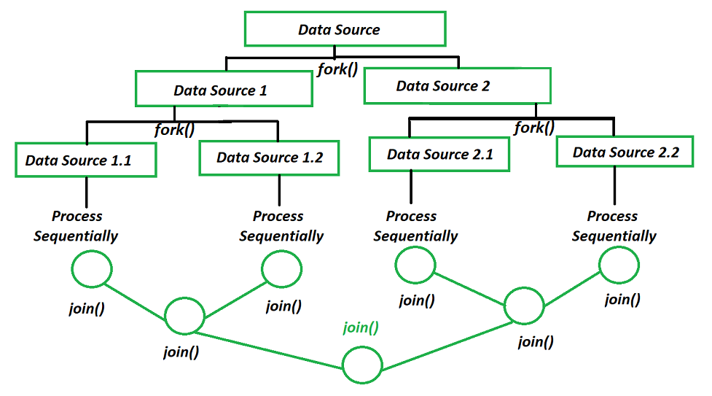

Slide 33
Questions?
https://github.com/LoiDinh911/functional-programming-with-java

